Slide 1
NOVA Tech
Requirements Specification

Slide 2
Welcome
Client: Dr. Erik Eddy
CEO of TEAMS 101
Guest: Dr. Meg Fryling
Guest: Dr. Darren Lim

Slide 3
Agenda
Introduction
Problem Overview
Current Status
User Case Narratives
UML Use Case Diagram
Data Flow Diagrams
Functional Requirements
Non-Functional Requirements
Prototypes
What’s Next

Slide 4
Introduction
Emma Bostian – Team Lead
Kevin Conner – Web Master
Dave Hall – Database Administrator
Sara Pinti – System Administrator
Justin Rose – Software Engineer

Slide 5
Agenda
Introduction
Problem Overview
Current Status
User Case Narratives
UML Use Case Diagram
Data Flow Diagrams
Functional Requirements
Non-Functional Requirements
Prototypes
What’s Next

Slide 6
Problem Overview
Client: Dr. Erik Eddy
Team Evaluation: Application on the TEAMS 101 Portal
Currently no website for teammates to provide group evaluations
Groups only provide feedback after project has terminated
Notes:
Dr. Eddy studies how teams interact and qualities that successful groups display. Typical group evaluations do not hit on the specific group behaviors that are vital to a team’s success. Dr. Eddy has an understanding of the qualities that successful groups have and believes that this software will allow teams to operate more cohesively and ultimately more productively. By giving teammate feedback halfway through the project, team members are granted the ability to alter the way they interact with their team, in order to produce a better end result.

Slide 7
Agenda
Introduction
Problem Overview
Current Status
User Case Narratives
UML Use Case Diagram
Data Flow Diagrams
Functional Requirements
Non-Functional Requirements
Prototypes
What’s Next

Slide 8
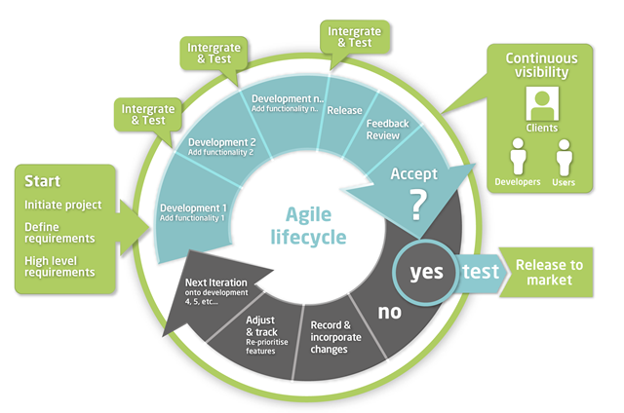
Current Status
Defining Requirements
Notes:
Dr. Eddy would like the software to be stress free and easy to access. Teammate Evaluation will allow students convenient access to the site and will not be time consuming. It will allow students to produce anonymous evaluations, which will encourage honest answers. Teammate Evaluation will also allow the administrator a full view of their student’s progress, giving them a comprehensive view of the team dynamic. Ultimately this provides students with a better team experience, and gives them liberty to adjust their work ethic throughout the project in order to obtain a better participation grade.

Slide 9
Agenda
Introduction
Problem Overview
Current Status
User Case Narratives
UML Use Case Diagram
Data Flow Diagrams
Functional Requirements
Non-Functional Requirements
Prototypes
What’s Next

Slide 10
User Case Narratives
Describes the interaction between a user and the system to achieve a goal
Notes:
To reiterate a few of the highlights of the software, Teammate Evaluation will be an easily accessible website. It will provide student the opportunity to utilize the evaluations without the constraint of obtaining a new username and password. The administrator will be able to toggle between administrator view, where they can alter the teams, view individual evaluations, etc. and student view where they can use the site as a student. Another goal of the software is to give administrators the ability to email the Team Evaluation link to their students, and have them access it through their email accounts. As the students complete the evaluations, participation grades will be generated and updated on Blackboard.

Slide 11
Student Narrative
Create Account
Complete Evaluations
View Evaluations
Notes:
To reiterate a few of the highlights of the software, Teammate Evaluation will be an easily accessible website. It will provide student the opportunity to utilize the evaluations without the constraint of obtaining a new username and password. The administrator will be able to toggle between administrator view, where they can alter the teams, view individual evaluations, etc. and student view where they can use the site as a student. Another goal of the software is to give administrators the ability to email the Team Evaluation link to their students, and have them access it through their email accounts. As the students complete the evaluations, participation grades will be generated and updated on Blackboard.

Slide 12
Faculty Member Narrative
Establish Class Roster/Team Profiles
Manage Evaluations
View Team/Individual Evaluations
Notes:
To reiterate a few of the highlights of the software, Teammate Evaluation will be an easily accessible website. It will provide student the opportunity to utilize the evaluations without the constraint of obtaining a new username and password. The administrator will be able to toggle between administrator view, where they can alter the teams, view individual evaluations, etc. and student view where they can use the site as a student. Another goal of the software is to give administrators the ability to email the Team Evaluation link to their students, and have them access it through their email accounts. As the students complete the evaluations, participation grades will be generated and updated on Blackboard.

Slide 13
System Administrator Narrative
Manage User Permissions
Notes:
To reiterate a few of the highlights of the software, Teammate Evaluation will be an easily accessible website. It will provide student the opportunity to utilize the evaluations without the constraint of obtaining a new username and password. The administrator will be able to toggle between administrator view, where they can alter the teams, view individual evaluations, etc. and student view where they can use the site as a student. Another goal of the software is to give administrators the ability to email the Team Evaluation link to their students, and have them access it through their email accounts. As the students complete the evaluations, participation grades will be generated and updated on Blackboard.

Slide 14
Agenda
Introduction
Problem Overview
Current Status
User Case Narratives
UML Use Case Diagram
Data Flow Diagrams
Functional Requirements
Non-Functional Requirements
Prototypes
What’s Next

Slide 15
UML Use Case Diagram
UML Use Case Diagram Legend
UML Use Case Diagram
Notes:
Dr. Eddy has high hopes for the software in terms of accessibility goals. However we have encountered some blocks regarding alternative software, such as Blackboard. We do not believe that we have access to update Blackboard with Team Evaluation grades. In order to remediate these constraints, we must meet with IT and discuss our jurisdiction with accessing Blackboard. Another constraint resides with the student login. Dr. Eddy wants the site to be easily accessible, where students do not have to create new user accounts. However, if the links to the Evaluation are distributed through a chain email, we need a way to denote which students are completing the evaluations. Thus, we will discuss an alternative method for keeping track of student progress. Lastly, students will be accessing this site from mobile devices, thus we need to design our software to account for this constraint.

Slide 16
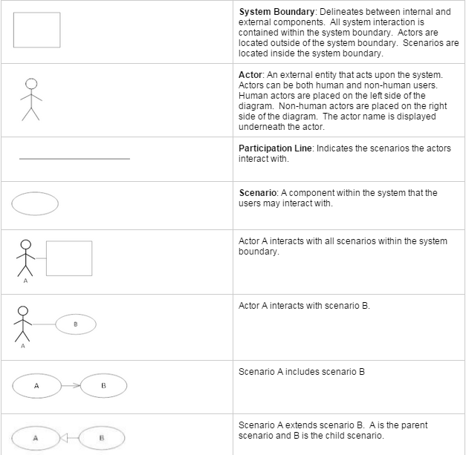
UML Use Case Diagram
UML Use Case Diagram Legend
Notes:
Dr. Eddy has high hopes for the software in terms of accessibility goals. However we have encountered some blocks regarding alternative software, such as Blackboard. We do not believe that we have access to update Blackboard with Team Evaluation grades. In order to remediate these constraints, we must meet with IT and discuss our jurisdiction with accessing Blackboard. Another constraint resides with the student login. Dr. Eddy wants the site to be easily accessible, where students do not have to create new user accounts. However, if the links to the Evaluation are distributed through a chain email, we need a way to denote which students are completing the evaluations. Thus, we will discuss an alternative method for keeping track of student progress. Lastly, students will be accessing this site from mobile devices, thus we need to design our software to account for this constraint.

Slide 17
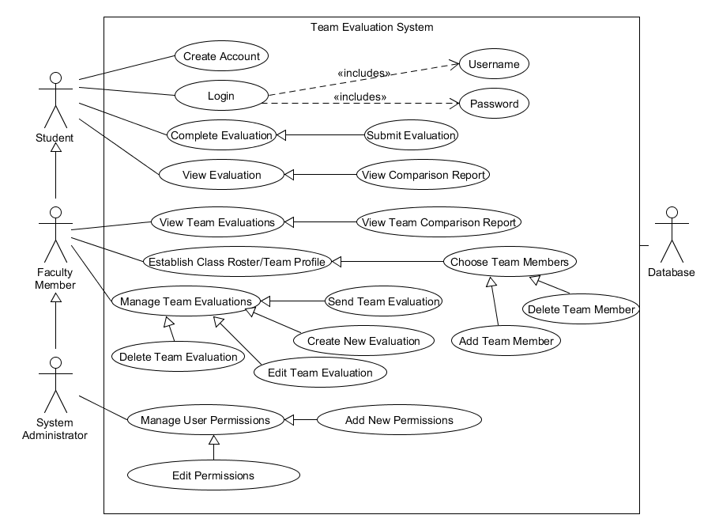
UML Use Case Diagram
Notes:
Dr. Eddy has high hopes for the software in terms of accessibility goals. However we have encountered some blocks regarding alternative software, such as Blackboard. We do not believe that we have access to update Blackboard with Team Evaluation grades. In order to remediate these constraints, we must meet with IT and discuss our jurisdiction with accessing Blackboard. Another constraint resides with the student login. Dr. Eddy wants the site to be easily accessible, where students do not have to create new user accounts. However, if the links to the Evaluation are distributed through a chain email, we need a way to denote which students are completing the evaluations. Thus, we will discuss an alternative method for keeping track of student progress. Lastly, students will be accessing this site from mobile devices, thus we need to design our software to account for this constraint.

Slide 18
Agenda
Introduction
Problem Overview
Current Status
User Case Narratives
UML Use Case Diagram
Data Flow Diagrams
Functional Requirements
Non-Functional Requirements
Prototypes
What’s Next

Slide 19
Data Flow Diagrams
Data Flow Diagram Legend
Context Diagram
Level 0 - Student/Faculty/System Administrator
Level 0 - Faculty Member/System Administrator
Level 1 - Create Account
Level 1 - Login
Level 1 - Evaluate Teammate
Level 1 - View Individual Report
Level 1 - View Team Report
Level 1 - Establish Class Roster/Team Profile
Level 1 - Manage Team Evaluations
Level 1 - Manage User Permissions

Slide 20
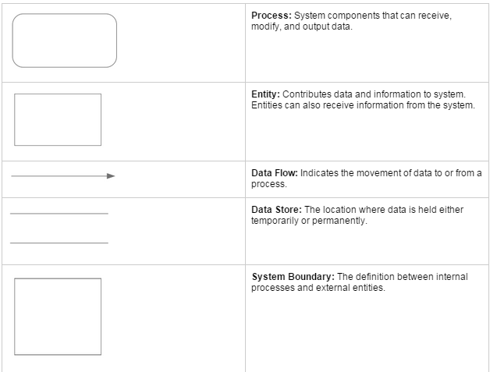
Data Flow Diagrams
Data Flow Diagram Legend

Slide 21
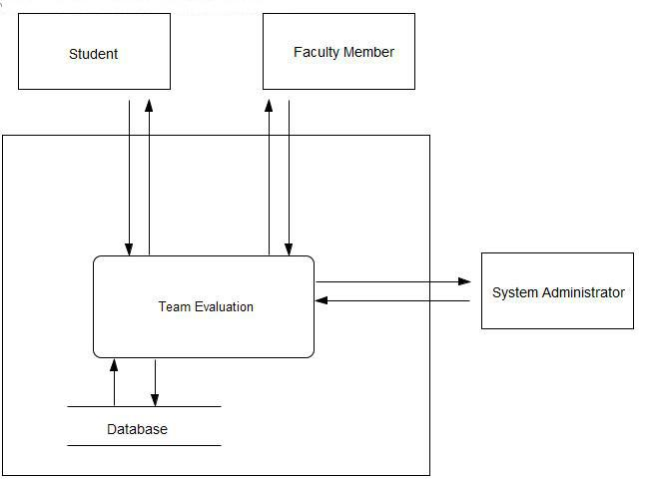
Data Flow Diagrams
Context Diagram

Slide 22
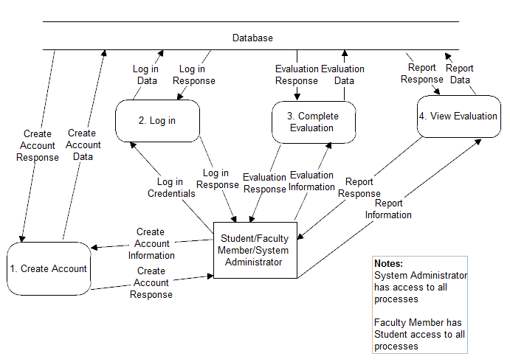
Data Flow Diagrams
Level 0 - Student/Faculty Member/System Administrator

Slide 23
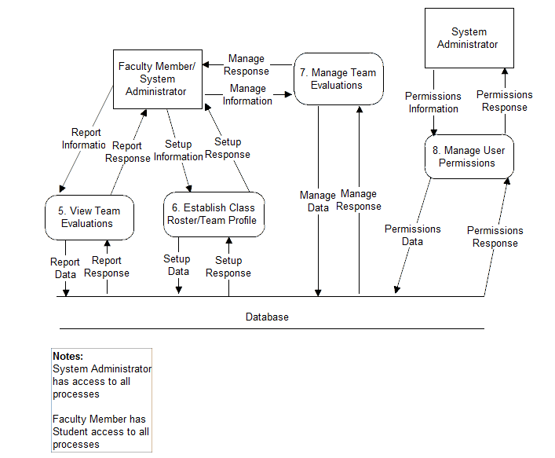
Data Flow Diagrams
Level 0 - Faculty Member/System Administrator

Slide 24
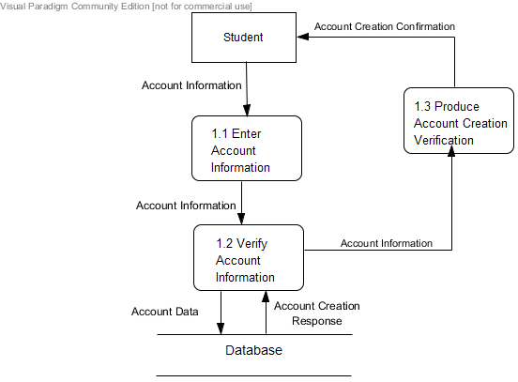
Data Flow Diagrams
Level 1 - Create Account

Slide 25
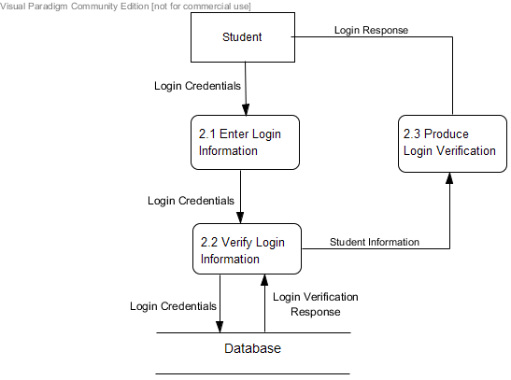
Data Flow Diagrams
Level 1 - Login

Slide 26
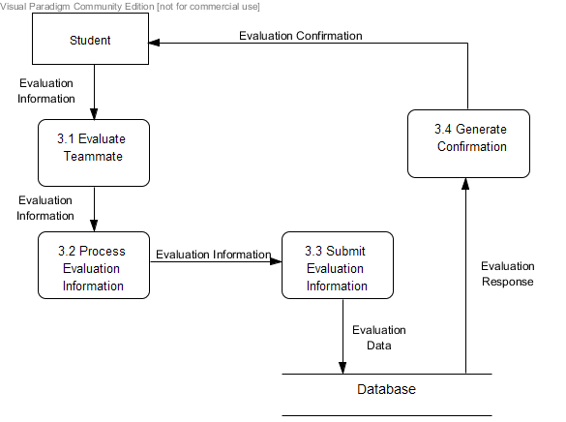
Data Flow Diagrams
Level 1 - Evaluate Teammate

Slide 27
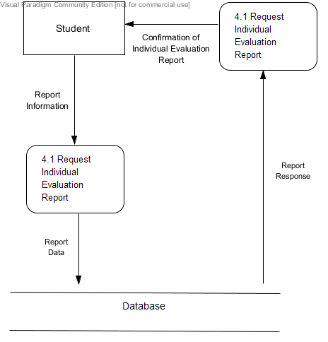
Data Flow Diagrams
Level 1 - View Individual Report

Slide 28
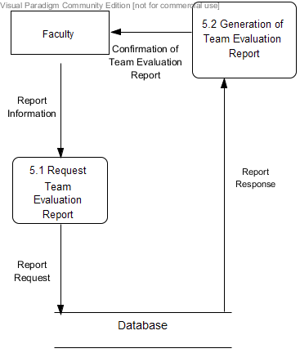
Data Flow Diagrams
Level 1 - View Team Report

Slide 29
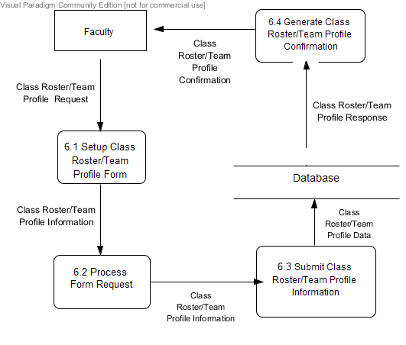
Data Flow Diagrams
Level 1 - Establish Class Roster/Team Profile

Slide 30
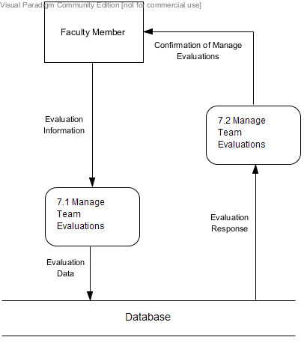
Data Flow Diagrams
Level 1 - Manage Team Evaluations

Slide 31
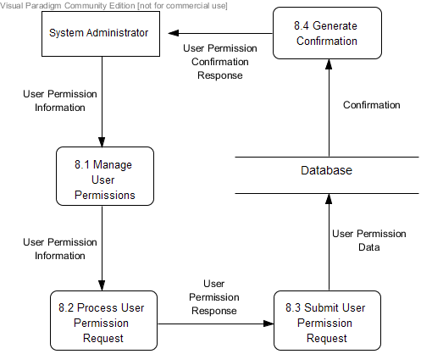
Data Flow Diagrams
Level 1 - Manage User Permissions

Slide 32
Agenda
Introduction
Problem Overview
Current Status
User Case Narratives
UML Use Case Diagram
Data Flow Diagrams
Functional Requirements
Non-Functional Requirements
Prototypes
What’s Next

Slide 33
Functional Requirements: Student
Capable of logging on system
Ability to fill out evaluation
Access own evaluation report
Able to log out of system

Slide 34
Functional Requirements: Faculty Member
Capable of Logging On System
Able to Fill out Evaluation for Any Student
Assign Teams/Replace Team Members
View All Student Evaluations
Ability to log out of system

Slide 35
Functional Requirements: System Administrator
Capable of Logging On System
Able to Fill out Evaluation for Any Student
Assign Teams/Replace Team Members
View All Student Evaluations
Grant Administrator Privileges
Ability to log out of system

Slide 36
Agenda
Introduction
Problem Overview
Current Status
User Case Narratives
UML Use Case Diagram
Data Flow Diagrams
Functional Requirements
Non-Functional Requirements
Prototypes
What’s Next

Slide 37
Non-Functional Requirements
Team Evaluation will be:
Efficient
User-Friendly
Compatible on All Browsers
Require Little Maintenance
Easily Accessible by All Users
Notes:
So again, to review, non-functional requirements are not specific features, but instead they are certain traits that might help the ease of use of the system. We have derived most of these non-functional requirements from our various meetings with Dr. Eddy. Listed here are a few of the key ones.
Efficiency / User friendliness - to me these two kind of go hand in hand. People want something that is easy, not bulky, and to the point. We don’t want to confuse people with too many features that they won’t use and will just get in the way. Also, some faculty members may not be as good with computers are not have time to learn a complicated application.
Compatibility on all browsers - this is simply a must-have for any modern day web application. It will never be very far-reaching if it can’t run on different types of browsers - people just won’t use it. I know I wouldn’t
Requires little maintenance - as stated above, we don’t want to the application to be very bulky so theoretically it should require little to no maintenance once it is established
Easily accessible - Trying to link up with siena college email and blackboard to make this application very easy link up with people’s lifestyles at siena college

Slide 38
Agenda
Introduction
Problem Overview
Current Status
User Case Narratives
UML Use Case Diagram
Data Flow Diagrams
Functional Requirements
Non-Functional Requirements
Prototypes
What’s Next

Slide 39
Prototypes
Notes:
Here is our beautiful logo that Sara kindly drew up for us. And when I click it, it will take us to a simple basic visual prototype that will hopefully help us to better visualize our plan for this system.

Slide 40
Student Login
Email:
dj21hall@siena.edu
Password:
**********
Login
Faculty Member? Click here
Notes:
Trying to keep it easy and work with siena college email addresses. Maybe even get a link sent to siena email addresses from professors. Type username, password, click login

Slide 41
Student Portal
Log off
Welcome!
Evaluate Team
View Evaluations
Notes:
Simple student portal, with our two main functions to chose from as a student. We may add more visually, but notice that we want to keep it very simple so that people will actually use our software. Let’s start by clicking evaluate team.

Slide 42
View Evaluations
Log off
Active Projects
Class | Project | Date
CSIS-410 | Requirements Specification | 10/28/2014
ECON-201 | Group Homework | 10/31/2014
CSIS-3500 | MySQL Project | 9/23/2014
Notes:
Takes you to a list of active projects that you can

Slide 43
Complete Evaluation
Log off
Evaluate each team member on a scale of 1 to 5 on the following criteria.
Team Member 1
Criteria 1:
1 | 2 | 3 | 4 | 5
1 | 2 | 3 | 4 | 5
1 | 2 | 3 | 4 | 5
1 | 2 | 3 | 4 | 5
1 | 2 | 3 | 4 | 5
1 | 2 | 3 | 4 | 5
1 | 2 | 3 | 4 | 5
Criteria 2:
Criteria 3:
Criteria 4:
Criteria 5:
Criteria 6:
Criteria 7:
Next
Notes:
Could be any number of criteria listed, and the scale could be from 1-10, but here is a quick representation of what an evaluation might look like. To reiterate, we need to do this for each member of the team. So we will fill out the boxes/bubbles by clicking, then click ‘next’ to proceed.

Slide 44
Complete Evaluation
Log off
Team Member 2
Criteria 1:
1 | 2 | 3 | 4 | 5
1 | 2 | 3 | 4 | 5
1 | 2 | 3 | 4 | 5
1 | 2 | 3 | 4 | 5
1 | 2 | 3 | 4 | 5
1 | 2 | 3 | 4 | 5
1 | 2 | 3 | 4 | 5
Criteria 2:
Criteria 3:
Criteria 4:
Criteria 5:
Criteria 6:
Criteria 7:
Next

Slide 45
Complete Evaluation
Team Member 3
Criteria 1:
1 | 2 | 3 | 4 | 5
1 | 2 | 3 | 4 | 5
1 | 2 | 3 | 4 | 5
1 | 2 | 3 | 4 | 5
1 | 2 | 3 | 4 | 5
1 | 2 | 3 | 4 | 5
1 | 2 | 3 | 4 | 5
Criteria 2:
Criteria 3:
Criteria 4:
Criteria 5:
Criteria 6:
Criteria 7:
Next

Slide 46
Complete Evaluation
Team Member 4
Criteria 1:
1 | 2 | 3 | 4 | 5
1 | 2 | 3 | 4 | 5
1 | 2 | 3 | 4 | 5
1 | 2 | 3 | 4 | 5
1 | 2 | 3 | 4 | 5
1 | 2 | 3 | 4 | 5
1 | 2 | 3 | 4 | 5
Criteria 2:
Criteria 3:
Criteria 4:
Criteria 5:
Criteria 6:
Criteria 7:
Submit
Notes:
Get to the end, maybe get bored and make a cool pattern, then click submit. Which will take you back to your student portal

Slide 47
View Evaluations
Log off
Class | Instructor
CSIS-410 | Frying, Lim
ECON-201 | Booker
CSIS-350 | Vandenberg
CSIS-400 | Lim

Slide 48
View Evaluations
Log off
CSIS-410
Fyring, Lim
Project | Date
Requirements Specification | 10/28
Software Plan | 9/23

Slide 49
View Evaluations
Log off
Average Scores
(out of 5)
Criteria 1 | 3
Criteria 2 | 2
Criteria 3 | 4
Criteria 4 | 2
Criteria 5 | 2
Criteria 6 | 1
Criteria 7 | 5

Slide 50
Faculty Login
Email:
Password:
Login
Faculty Member? Click here

Slide 51
Faculty Login
Faculty Email:
jdsmit@siena.edu
Password:
**********
Login

Slide 52
Faculty Portal
Log off
Welcome!
Create Teams
Establish Evaluations
View Evaluations

Slide 53
Agenda
Introduction
Problem Overview
Current Status
User Case Narratives
UML Use Case Diagram
Data Flow Diagrams
Functional Requirements
Non-Functional Requirements
Prototypes
What’s next?

Slide 54
Timeline: Fall Semester
Data Dictionary – November 10th
Software Testing Strategies – November 13th
Design Documents – November 26th
Preliminary Design – December 2nd
Notes:
The fall semester is primarily planning. We have established weekly team meeting do divide up the work. We also have bi-weekly client meetings to ensure that our software will meet the requirements Dr. Eddy desires.

Slide 55
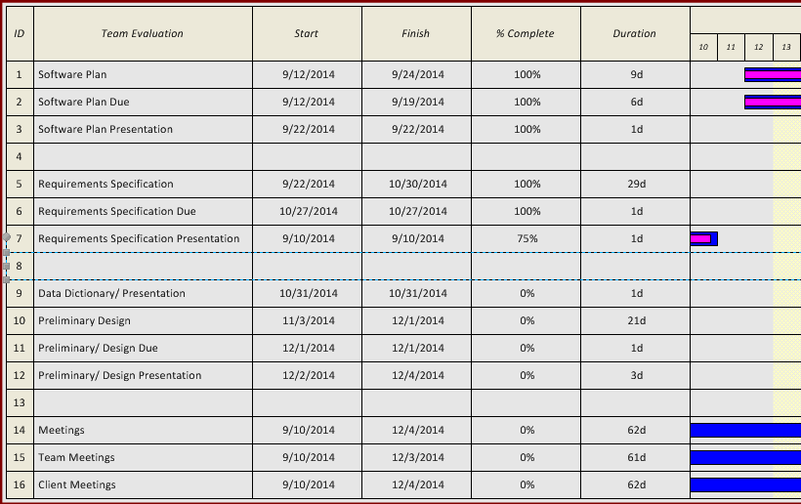
Timeline: Fall Semester
Notes:
The Gantt chart diagram displays the timeline for our project due dates. The overall software plan is broken down into specific components which will be completed at specific points in time throughout the fall semester. As the milestones are achieved, the Gantt chart will be updated. We’ve all seen these.

Slide 56
Conclusion
Questions?

