Slide 1
Frontend design refers to
The web server
Form processing
CSS coding
Database development
PHP Programming

Slide 2
Which of the following is something the W3C does?
Controls IP address allocation
Develops database protocols
Develops HTML standards
Controls domain names
Provides web hosting service

Slide 3
Consider this code <a href=“main.html”>Home</a>
What is the name of the HTML element? ____________________________________ What is the name of the HTML attribute? ____________________________________ What is the value of the HTML attribute? ____________________________________

Slide 4
HTML5 was initially proposed by
The W3C
The Mozilla Foundation
Google
WHATWG

Slide 5
What is the purpose of the p element?

Slide 6
What would you use the h1 element for?

Slide 7
Which HTML tag defines an item in a list? _____________
Which HTML tag defines a list that uses bullets instead of numbers? _____________

Slide 8
Which HTML tag defines the page content that will be displayed? _____________
Which HTML tags (list two) are single tags, i.e., they do not need an ending tag? _________________ and ________________

Slide 9
If all paragraphs have a top margin of 10px and a bottom margin of 20px, how much space will there be between two vertically adjacent paragraphs.
10px
20px
30px
40px

Slide 10
What is the name of the HTML attribute for specifying the URL of an image?________________

Slide 11
Which of these are Absolute URLs? (circle all that apply)
http://www.espn.com
news/us/topstory.html
http://ares.cs.siena.edu/index.html
www.cnn.com/
../images/hat.gif
http://isecon.org

Slide 12
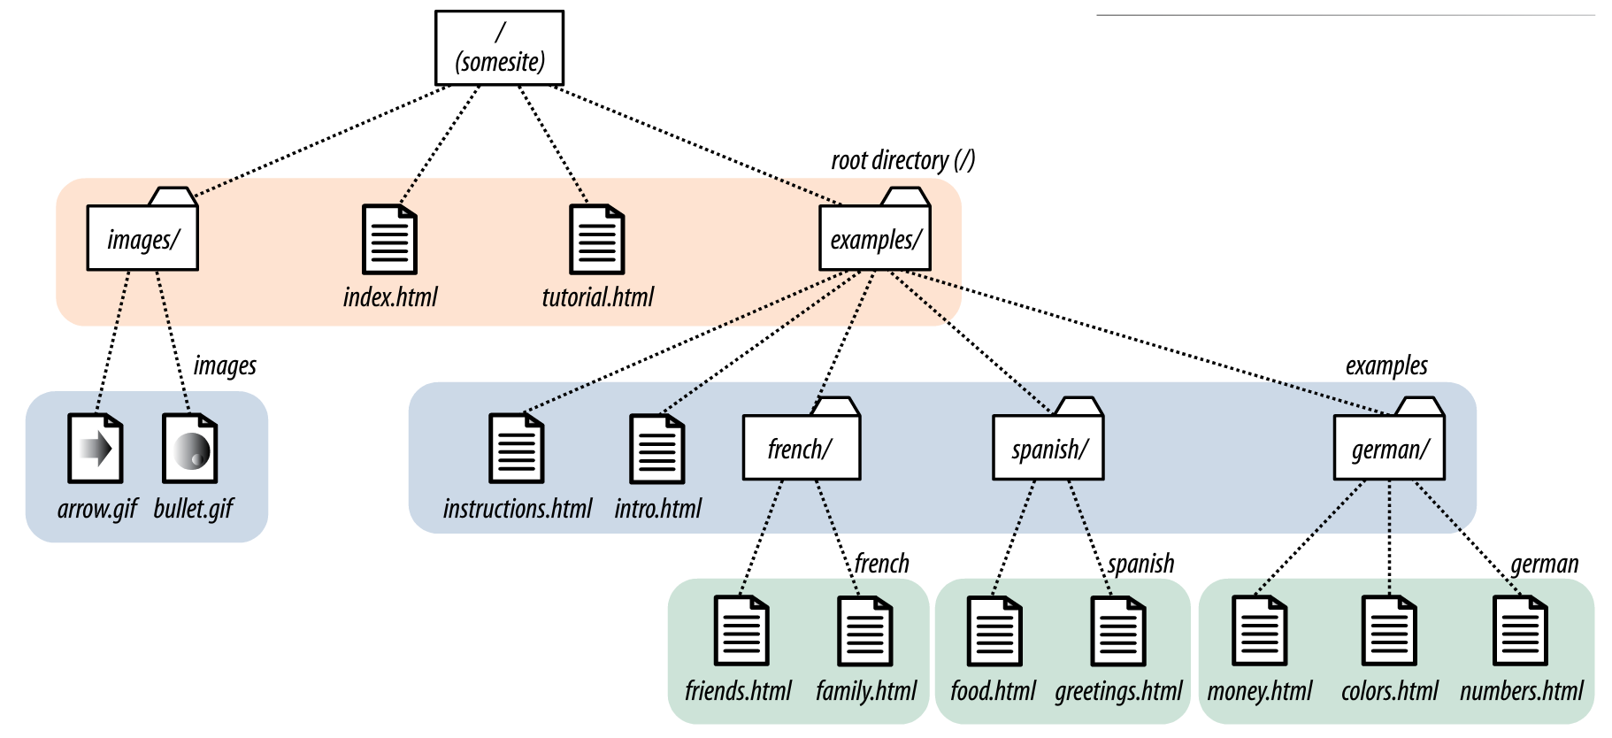
From the homepage (index.html), write the HTML code to create a hyperlink with the text “Tutorial” that will link to tutorial.html.

Slide 13
From the homepage (index.html), write the HTML code to insert the arrow image (arrow.gif).

Slide 14
From the food page (food.html), write the HTML code to create a hyperlink with the text “Money” that will link to money.html.

Slide 15
Which of these is free from HTML validation errors
<img source="pic.jpg alt="a picture">
<image src="pic.jpg" alt="a picture">
<img scr="pic.jpg" alt="a picture">
<img src="pic.jpg" alt="a picture">

Slide 16
Write the HTML code for properly formatting the following data: First Last Age Bob Jones 50 John Doe 65 Be sure to properly use the four basic table tags

Slide 17
Fix the validation errors in the code below. You can cross out code and add your correction in the code below
<em><strong>This is a emphasized and strong</em></strong> <em>This is a emphasized</em> <p class=“intro”This is the introductory paragraph</p>

